Slide 1
CITY CONNECT CAR LOAN PROCESSING SYSTEMS

Slide 2

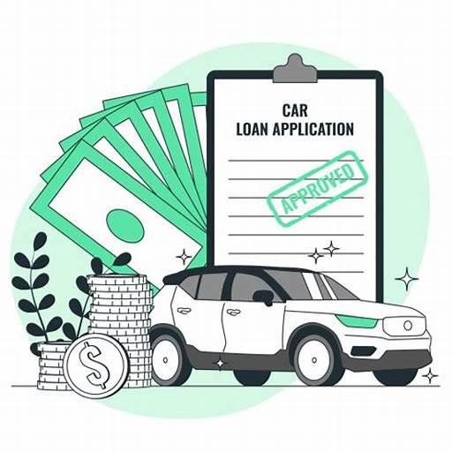
CONTENTS
INTRODUCTION
REQUIREMENT ANALYSIS
FLOW DIAGRAMS
PHASES

Slide 3
INTRODUCTION

Slide 4
The tasks involve loading applicant and car loan details into the bank's database, updating repayment details from collection agencies and CITY CONNECT Bank, and generating daily and weekly reports on car loan repayments. Additionally, there is a task for cleaning up and loading applicant, car loan, and payment data into the history database.

Slide 5
REQUIREMENT ANALYSIS

Slide 6
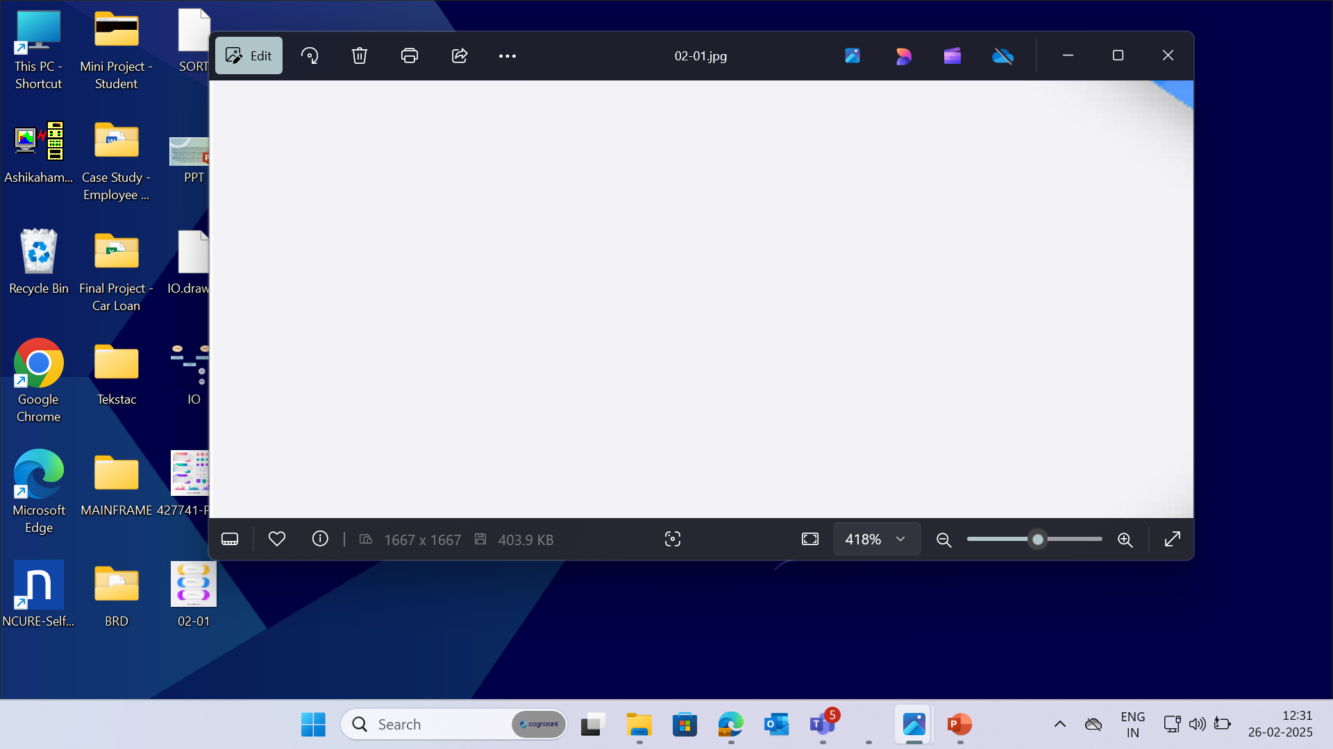


PCOMM Emulator - to access the Mainframe environment.
Pcom Emulator
SOFTWARE
REQUIREMENTS
DB2 - used for storing
the data in format.
TSO, JCL – to run and execute programs.
COBOL – to access inputs and perform required computations.
6
© 2025–2027 Cognizant | Private

Slide 7
CONTEXT FLOW DIAGRAM

Slide 8
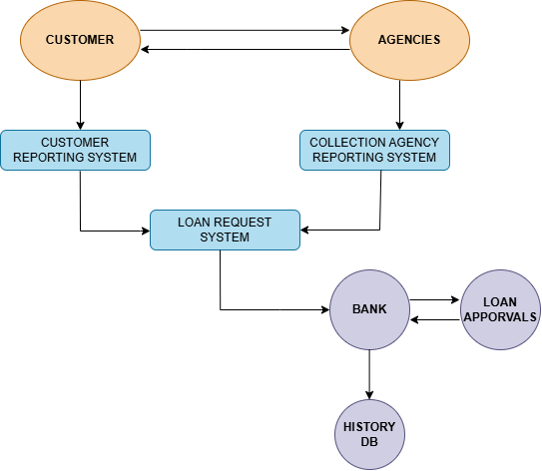
The context flow diagram shows loading applicant and car loan details, updating repayment information, generating repayment reports and cleaning/loading data into the history database.

Slide 9
DATA FLOW DIAGRAM

Slide 10
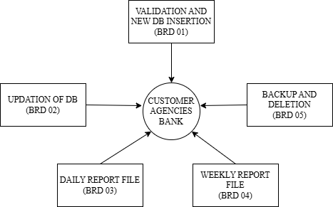
The Data Flow Diagram (DFD) visually represents the flow of data within a system, illustrating how data is processed.

Slide 11
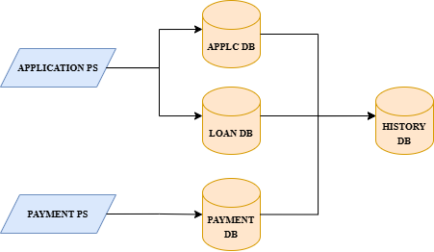
The below Flow Diagram depicts the overall process done in Car Loan Processing systems.

Slide 12
BUSINESS REQUIREMENT OVERIEW

Slide 13
BRD 01 - AISHWARYA NAGA SREEJA
SURYA UPPALA
(2372558)

Slide 14
BRD : 01 - Load Applicant and Car Loan Details
The objective is to efficiently process applicant and car loan details. This involves collecting and backing up the data, splitting loan details into short-term and long-term categories, and loading the information into their respective databases. The Master Loan VSAM KSDS file is updated with active loan details. Finally, a report is generated for applicants with loans over two years in the standard format.

Slide 15
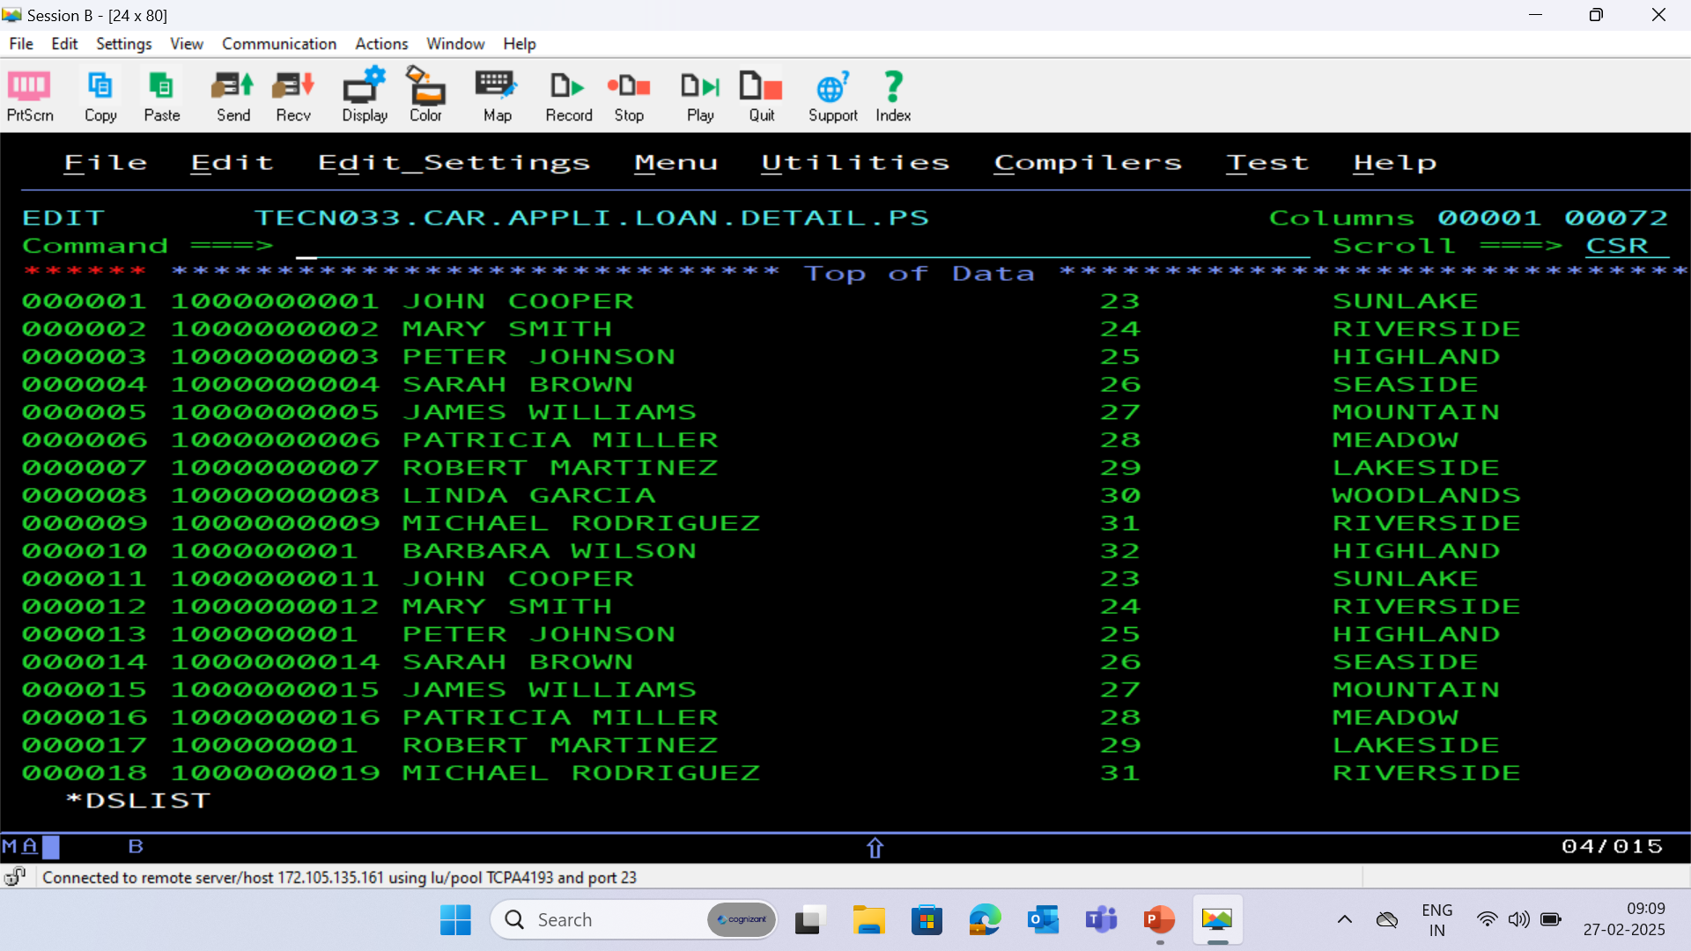
APPLICATION PS FILE

Slide 16
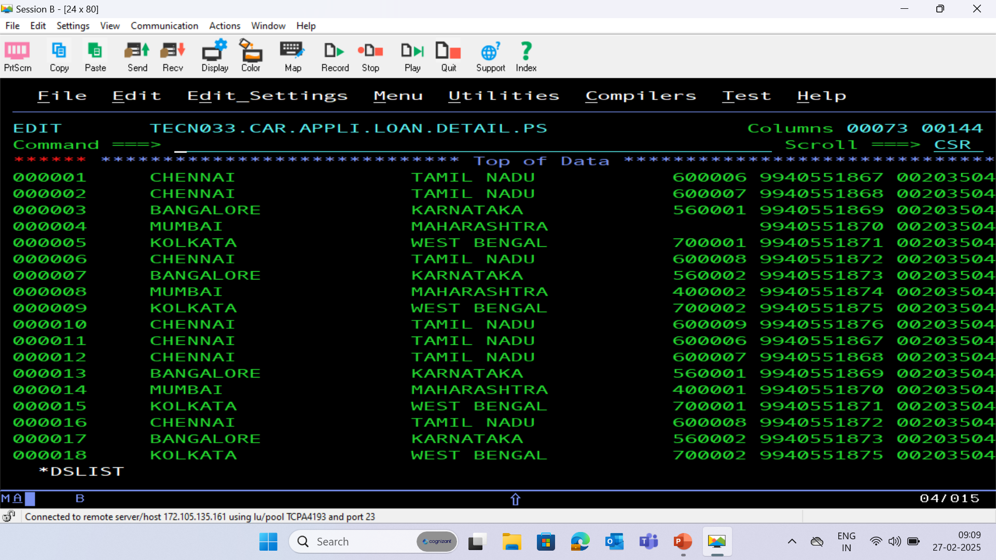

Slide 17
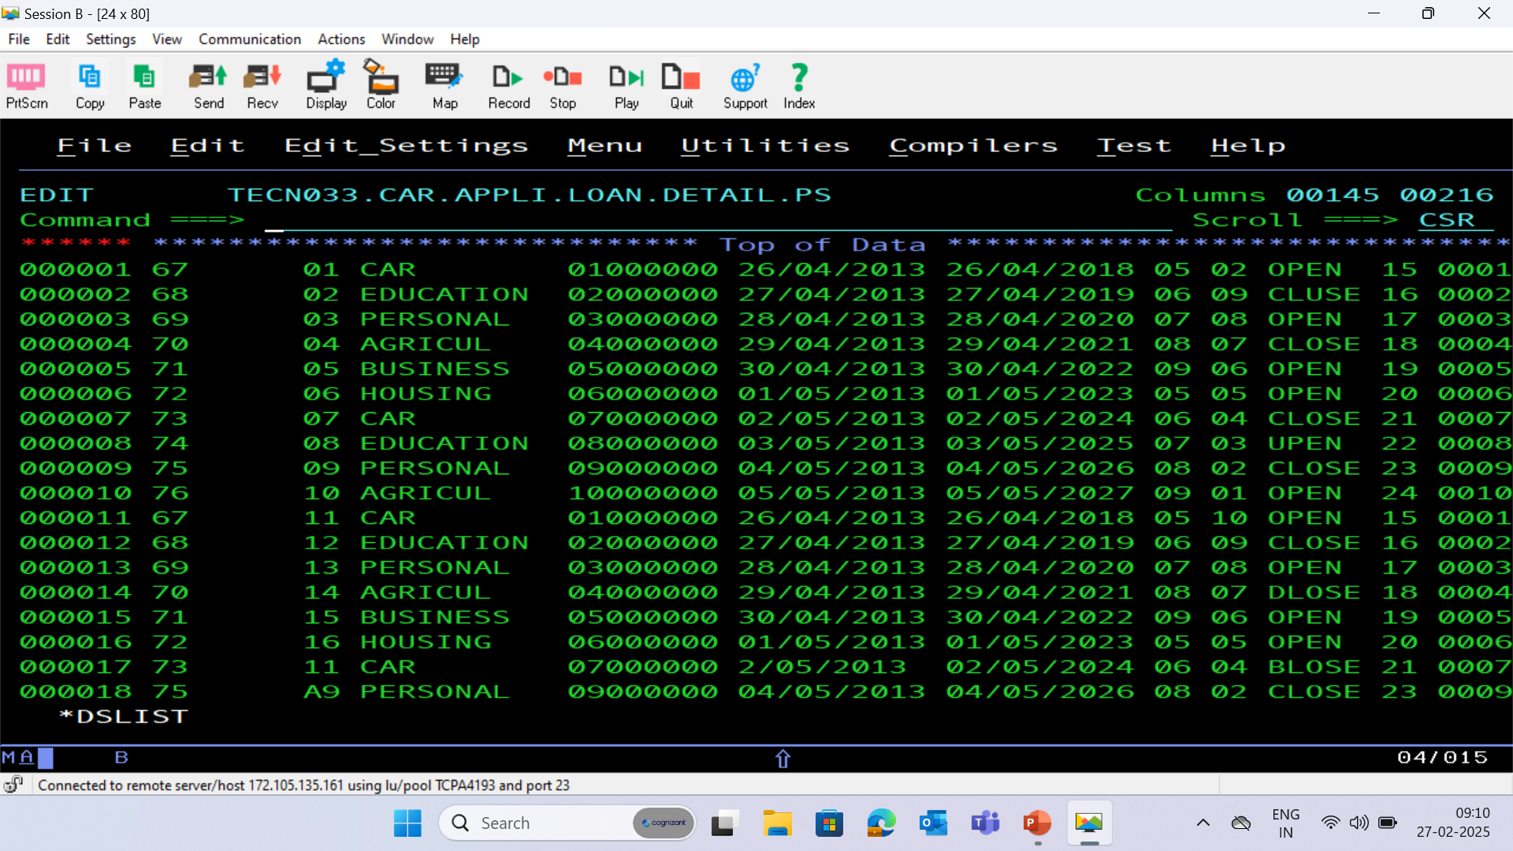

Slide 18
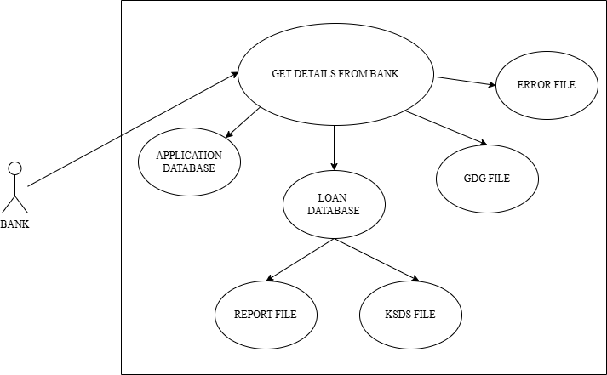
BRD : 01 – Use Case Diagram

Slide 19
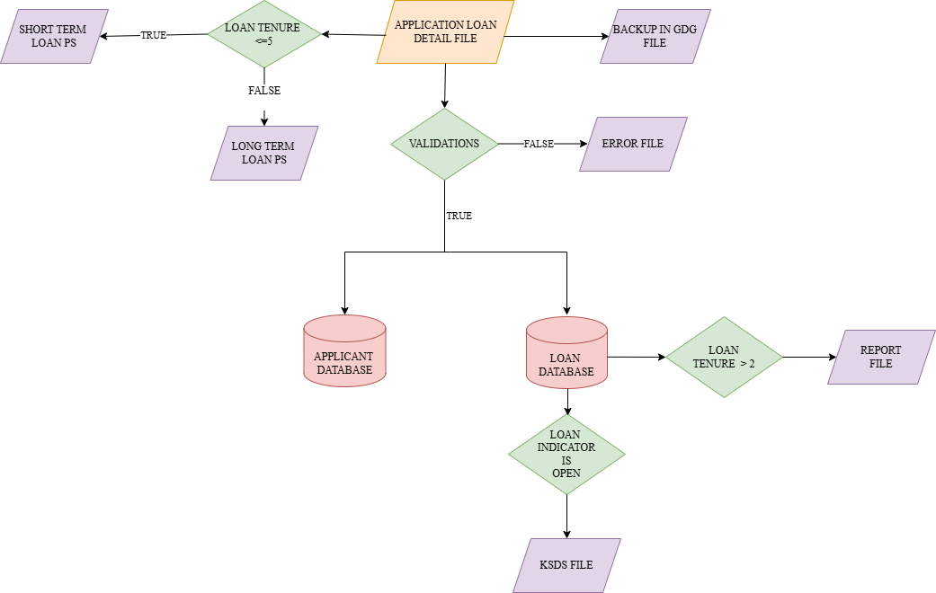
BRD : 01 – Flow Chart

Slide 20
PROCESS FLOW
Backing Up Data
The process begins by obtaining applicant and car loan details from the bank and storing this information in a GDG file with a limit of 16 versions, ensuring data is backed up securely.
2. Categorizing Loan Details
Next, the car loan details are split into two files based on loan tenure. Loans of 5 years or less are short-term, while those over 5 years are long-term, aiding in specialized processing by different divisions.
3. Loading Applicant Details
Applicant information, including ID, name, address, contact number, and savings account number, is loaded into the Application Database to maintain accurate records for further processing.

Slide 21
4. Loading and Updating Loan Details
Loan-specific details such as Loan ID, amount, approval date, closure date, balance, and next due date are loaded into the Loan Database. These details are also added to the Master Loan VSAM KSDS file, which contains records of all active loans.
5. Generating Reports
Details of applicants with loan tenures greater than two years are extracted from the Loan Database. Separate report files are generated for these applicants in a standard format, ensuring organized data presentation and readability.

Slide 22
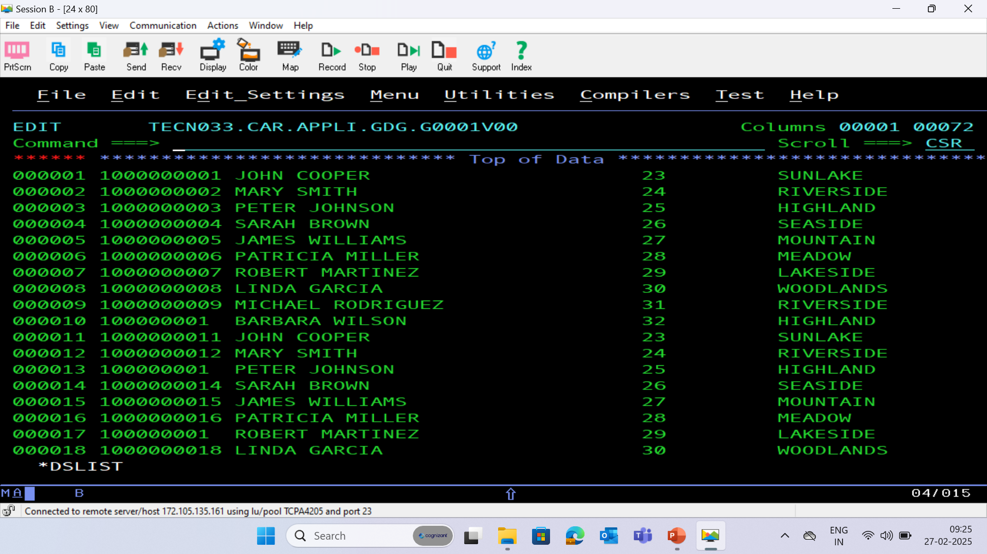
GDG BACKUP FILE

Slide 23
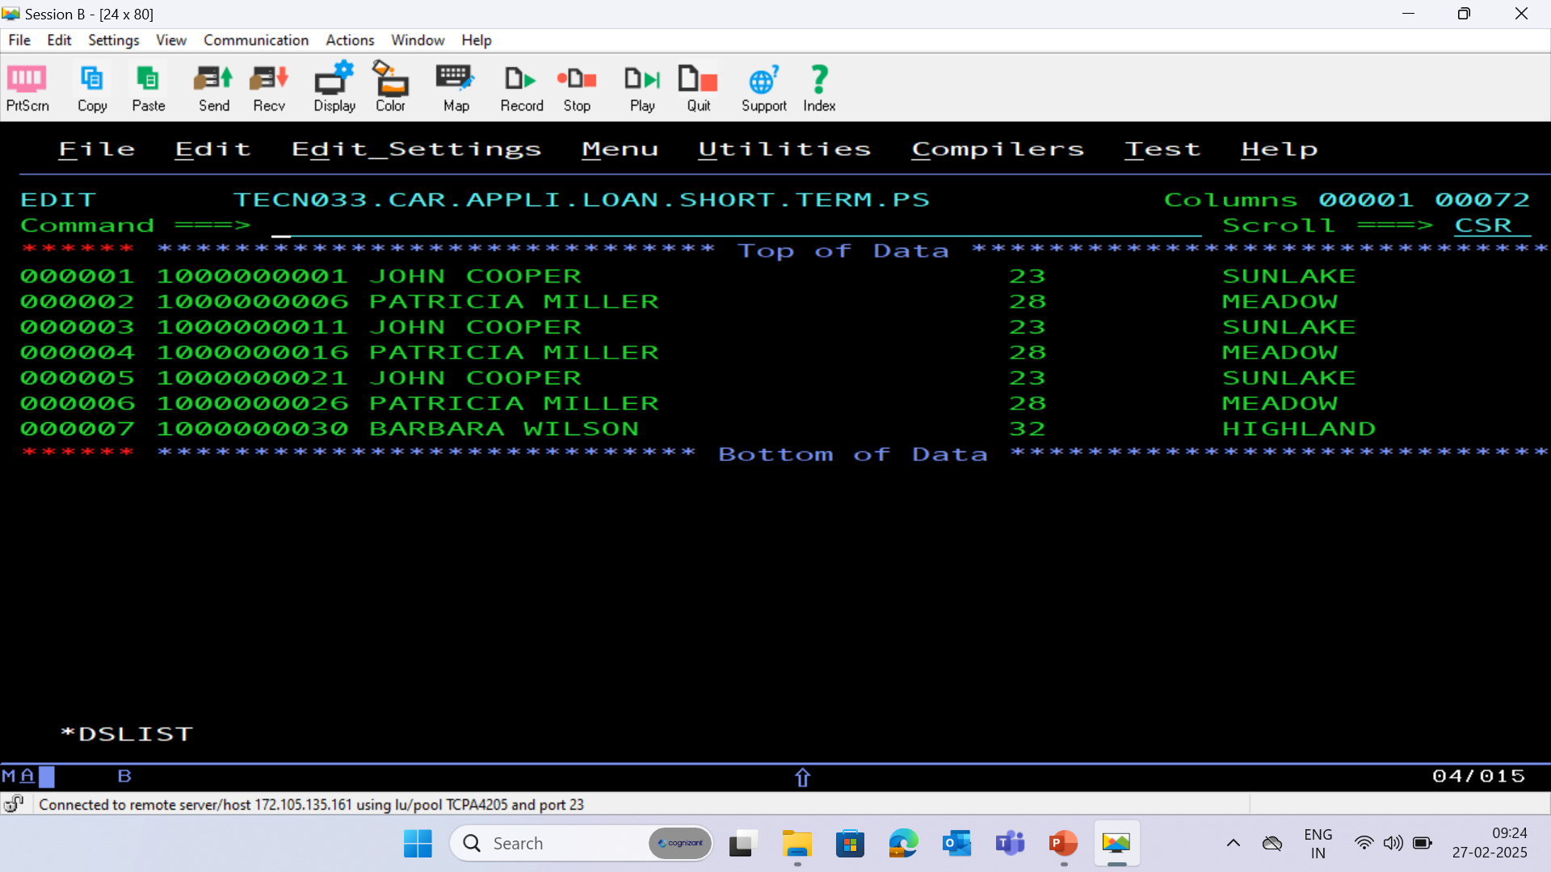
SHORT TERM PS FILE

Slide 24
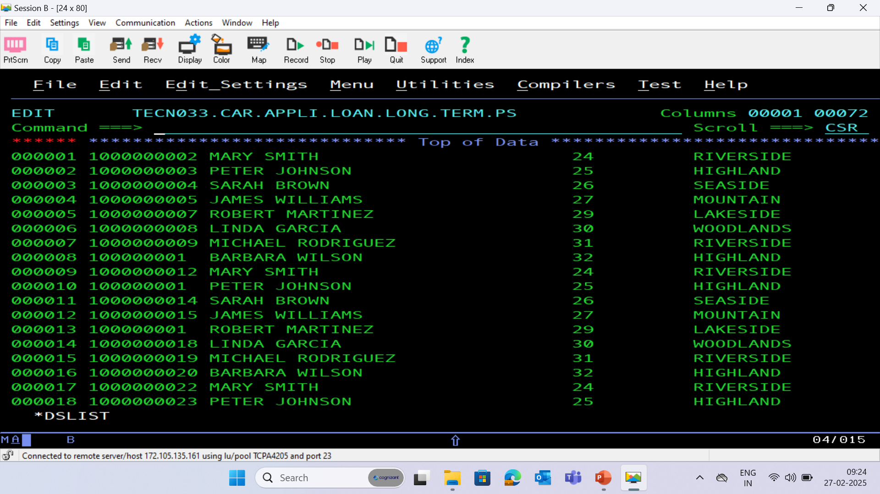
LONG TERM PS FILE

Slide 25
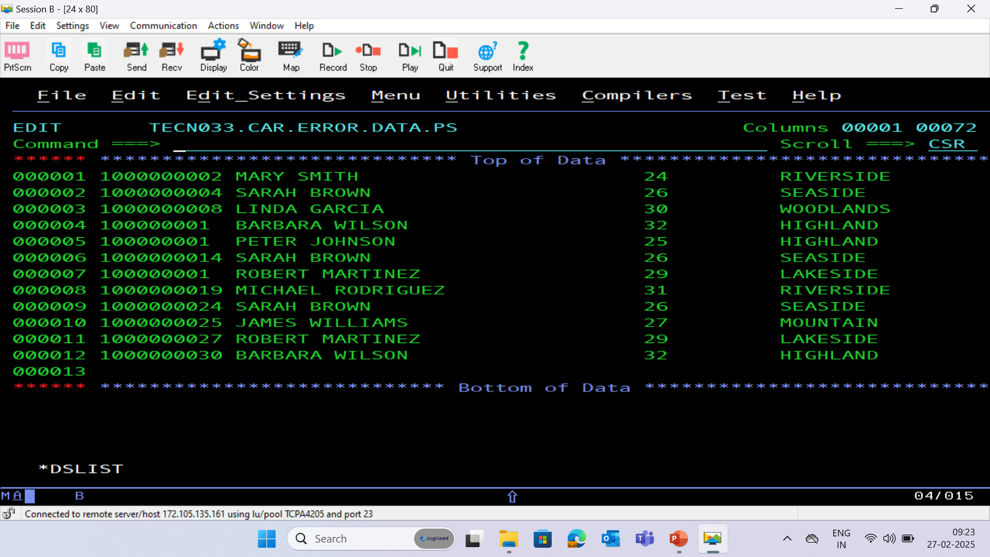
ERROR PS FILE

Slide 26
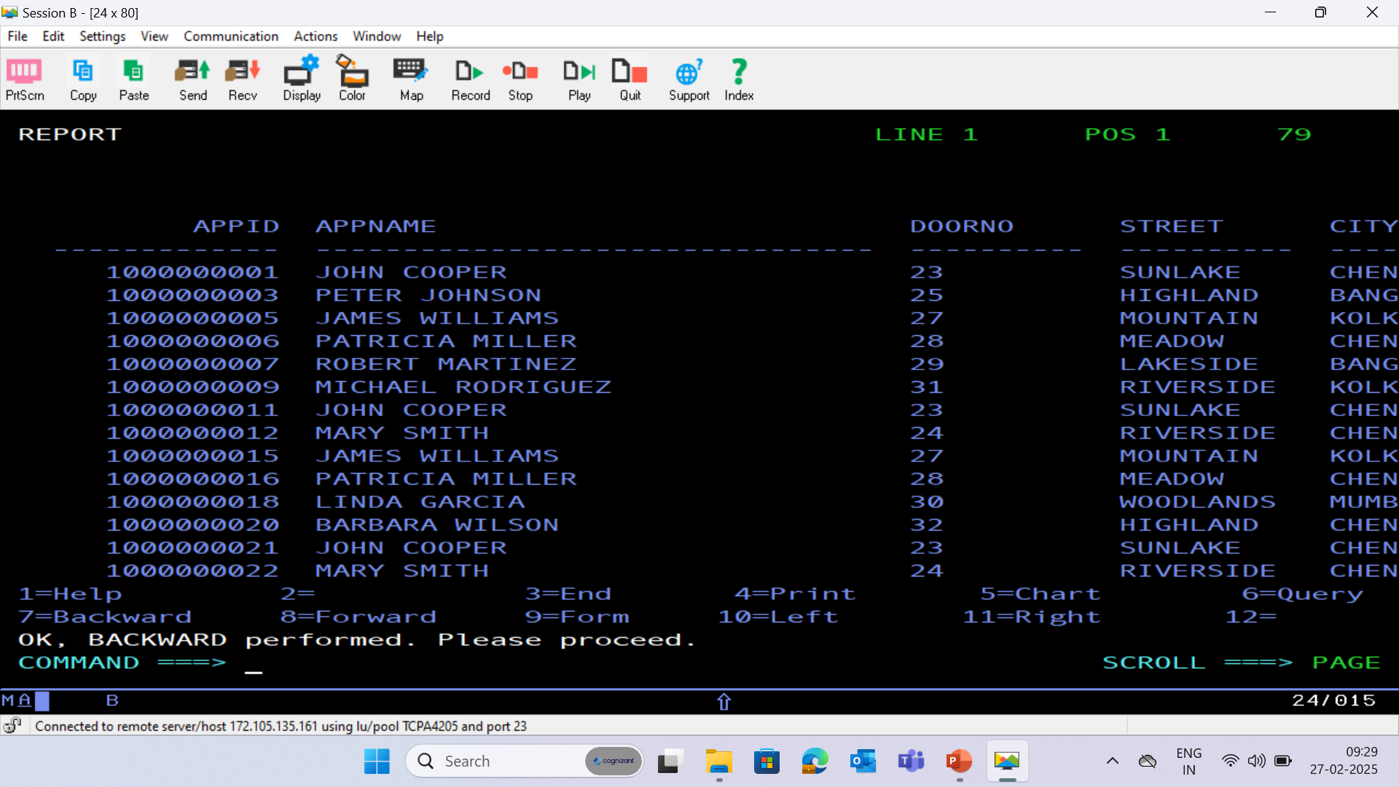
APPLICATION DATABASE - (APPLC)

Slide 27
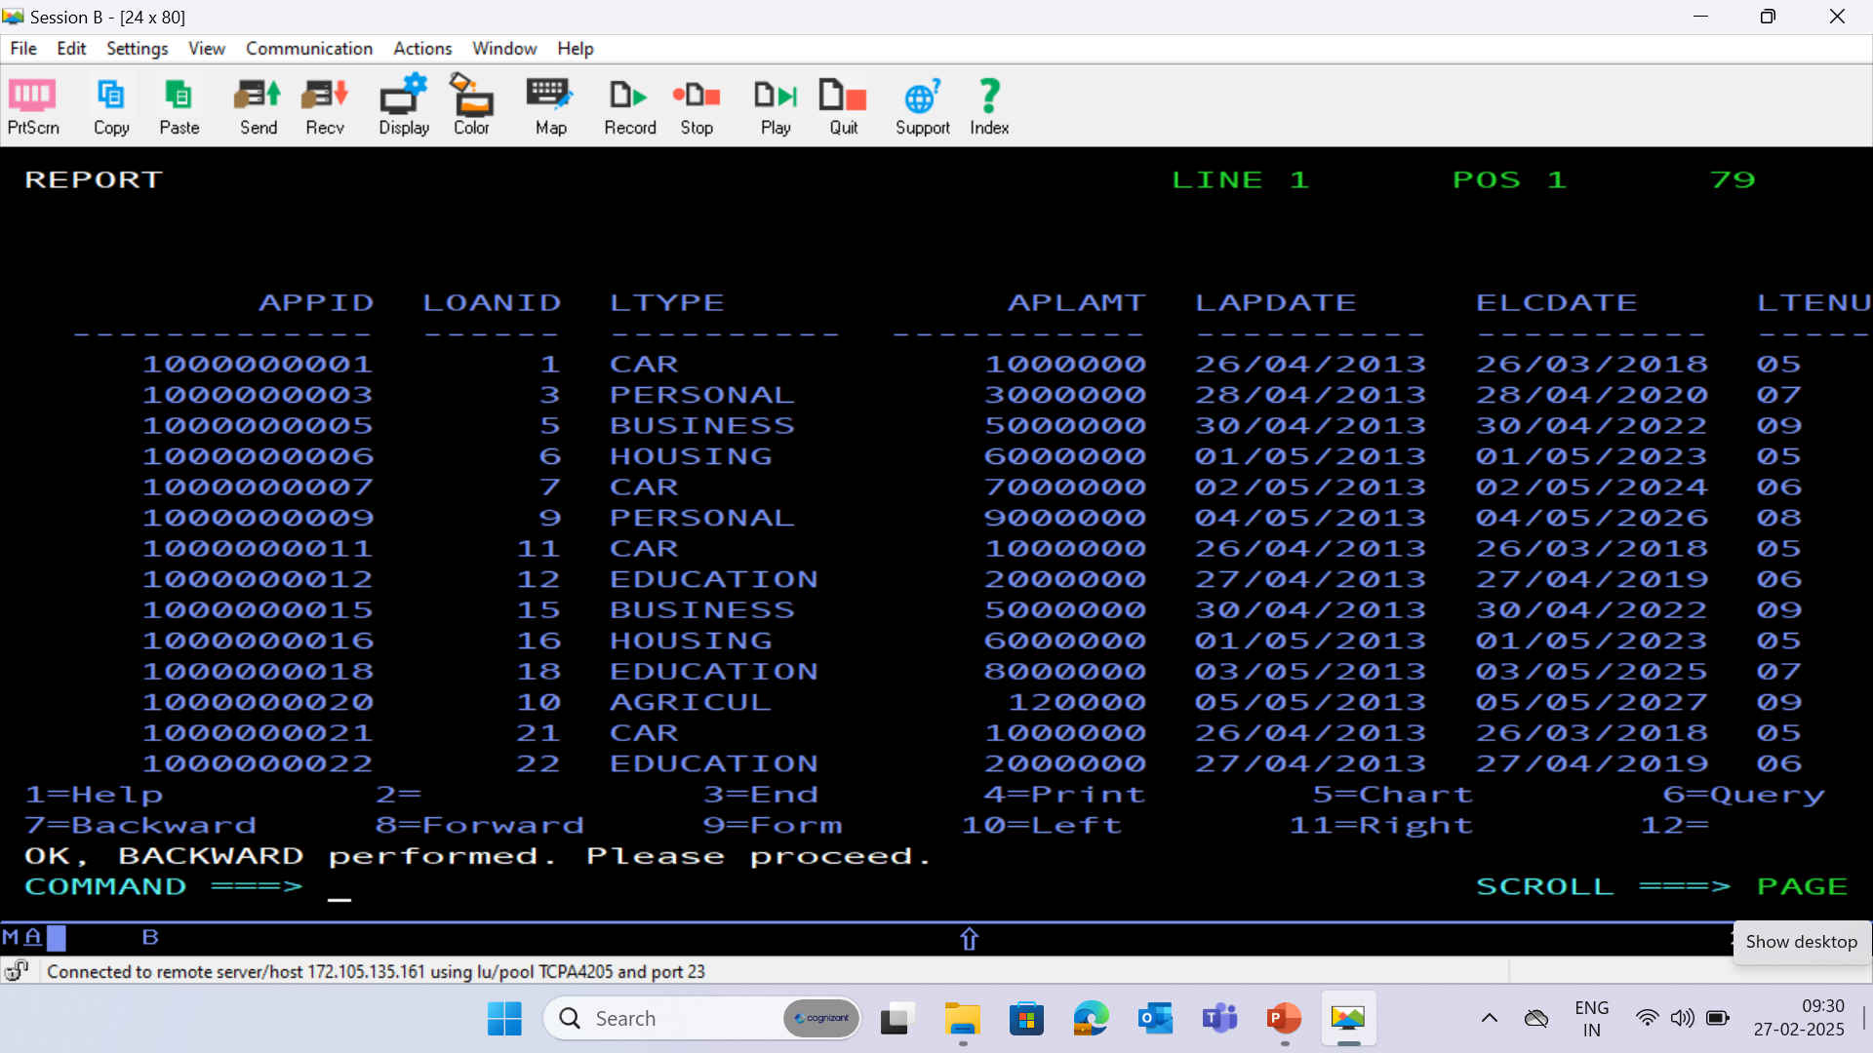
LOAN DATABASE - (LOAN)

Slide 28
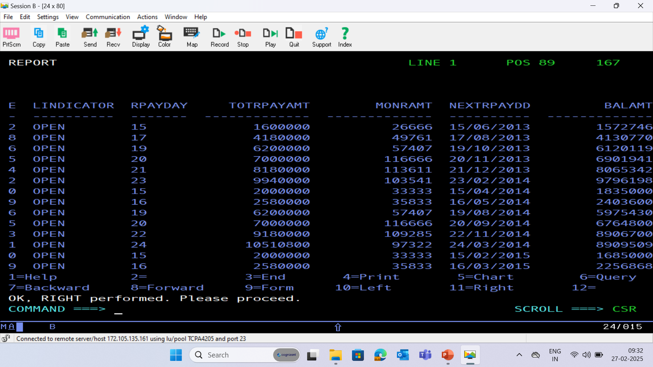

Slide 29
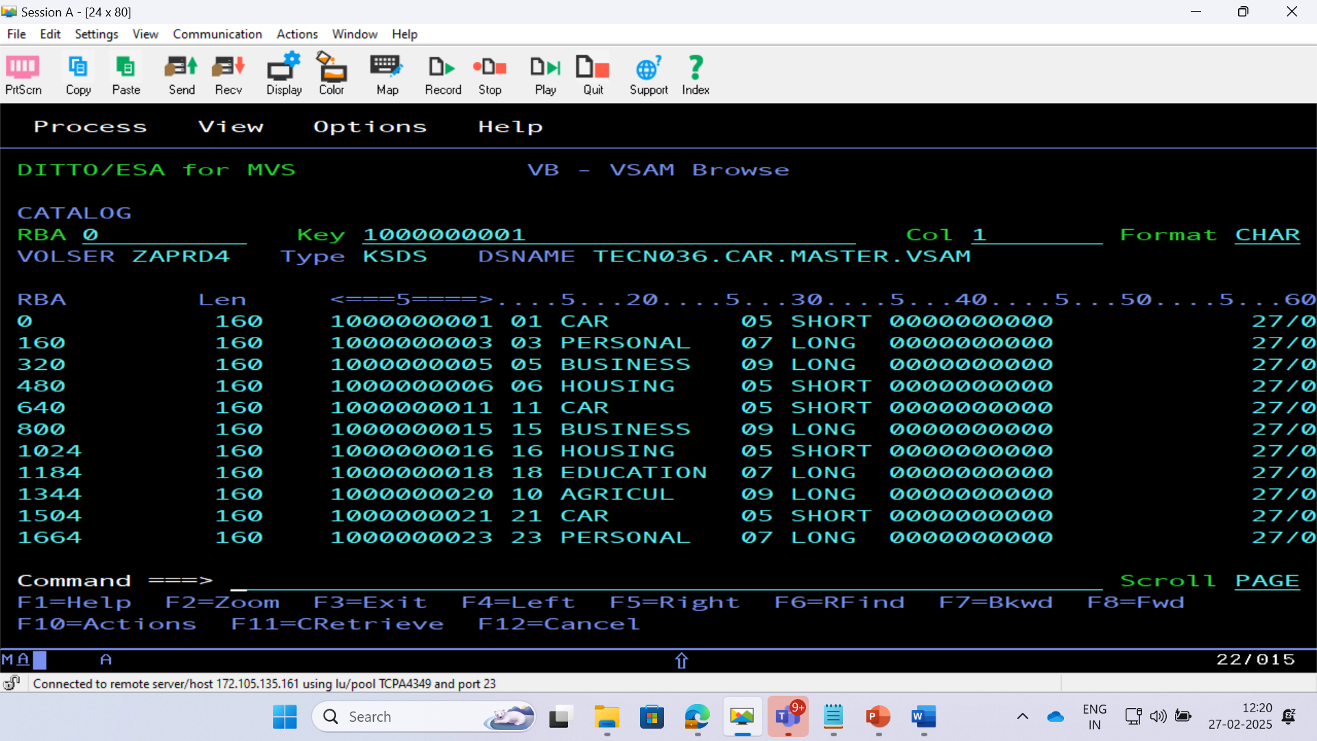
BRD 01 VSAM CLUSTER

Slide 30
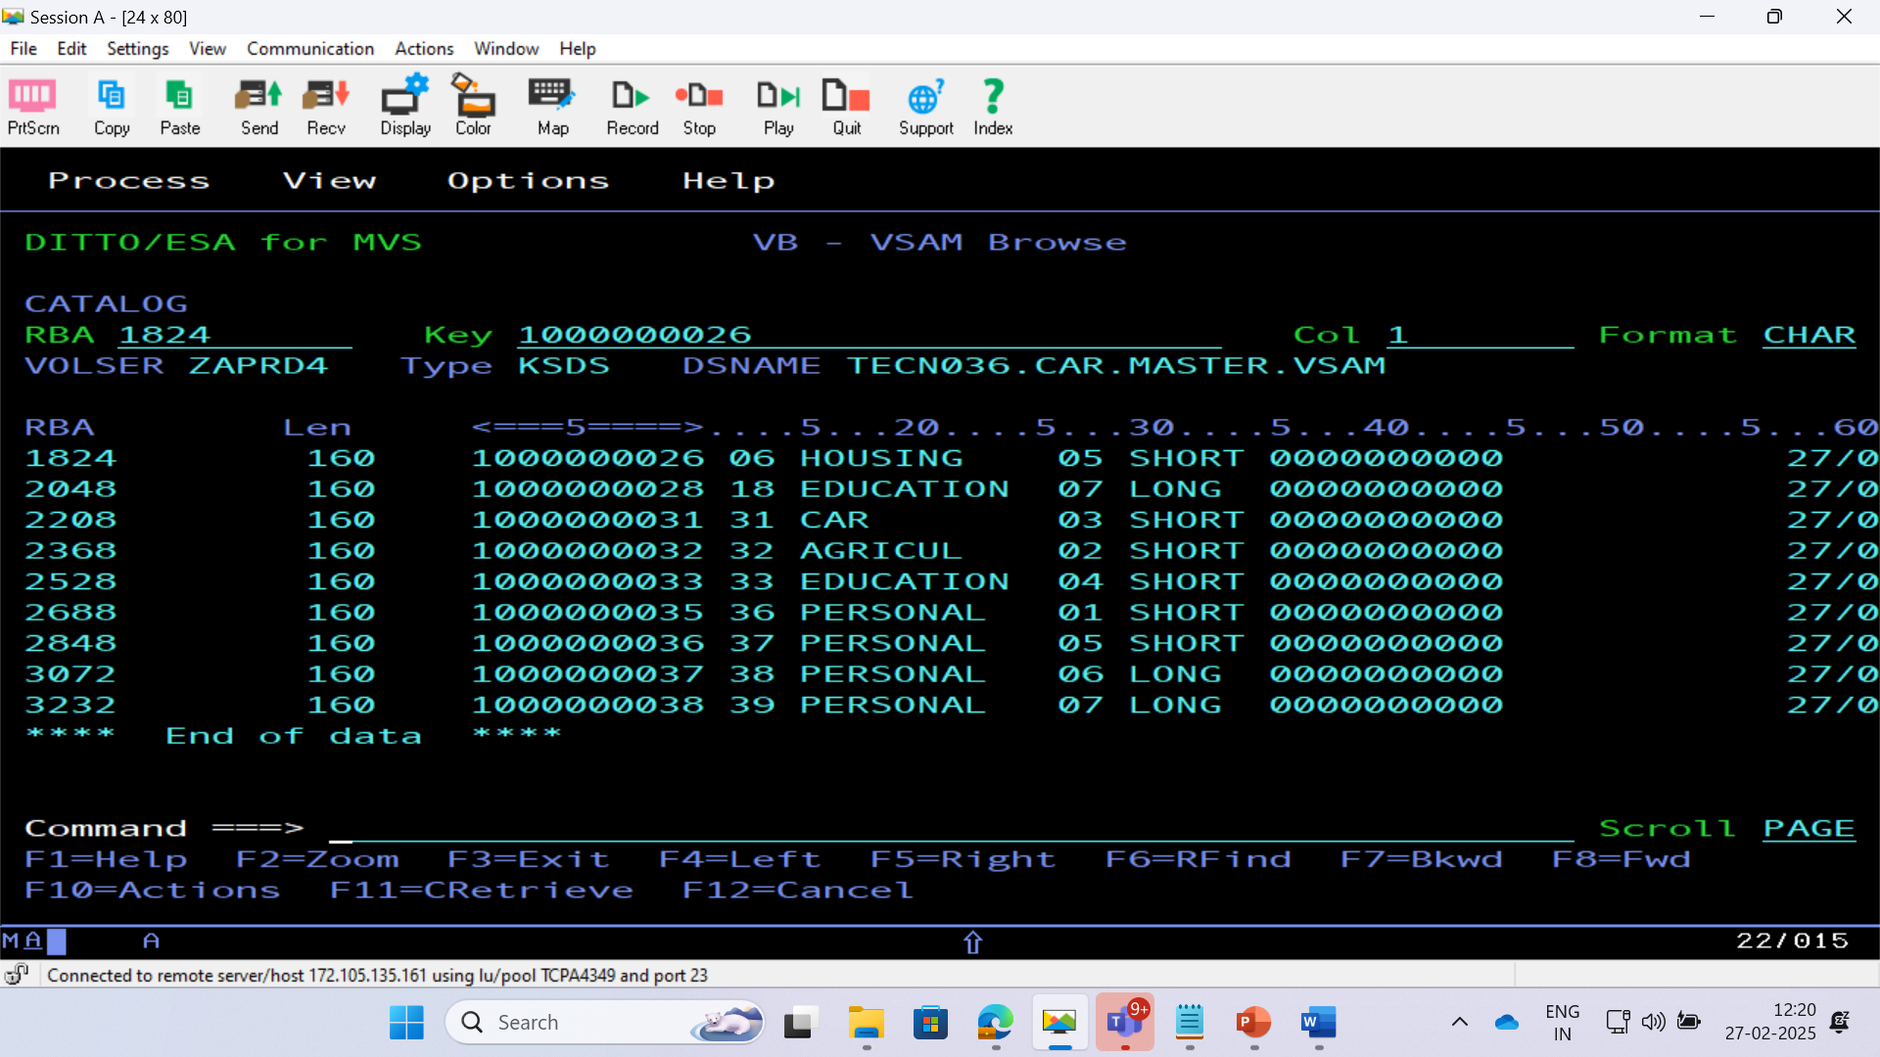

Slide 31
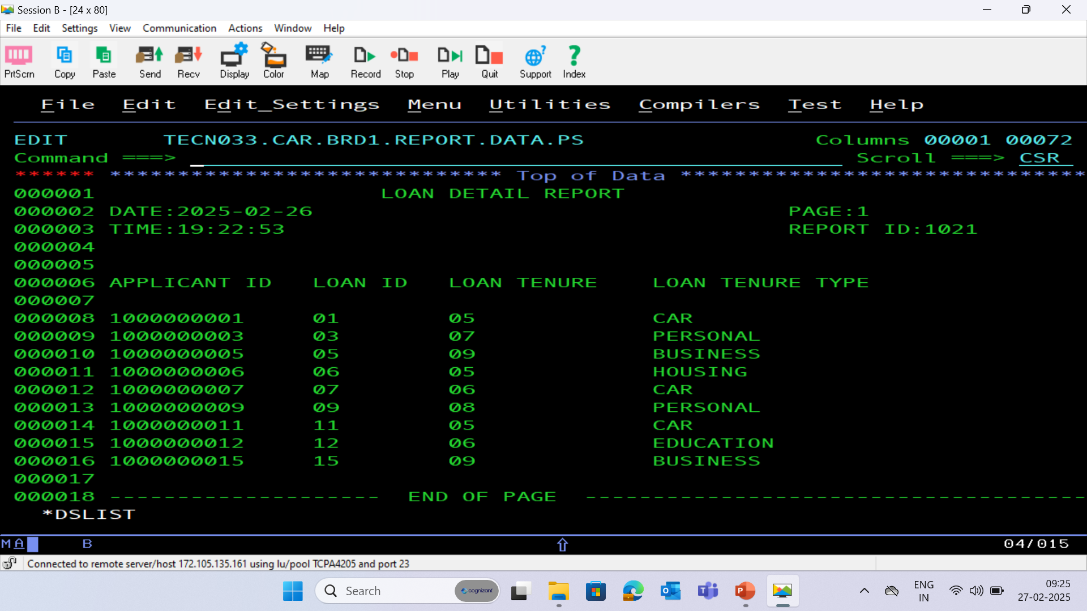
BRD 01 REPORT PS FILE

Slide 32
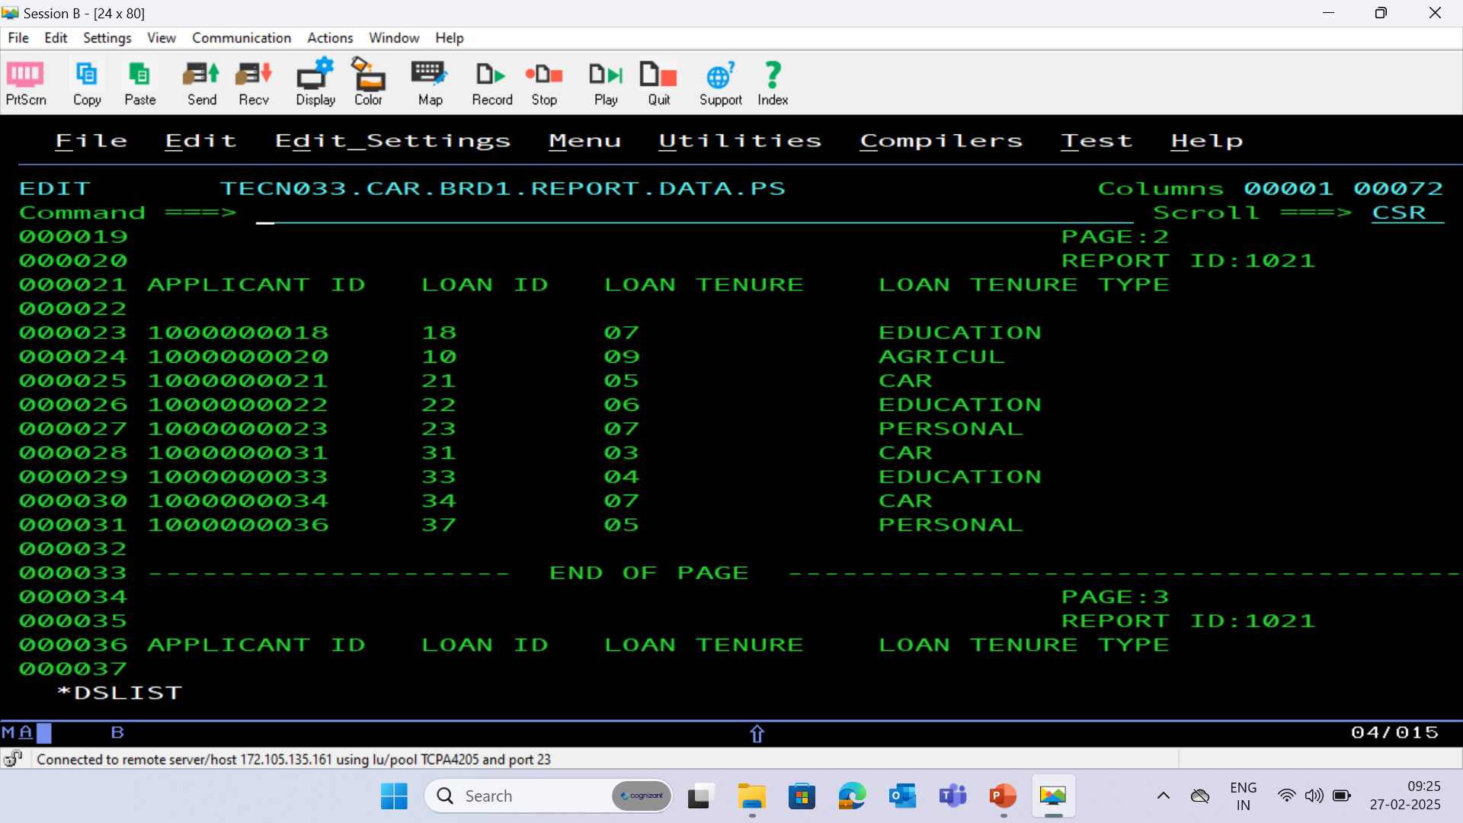

Slide 33
THANK YOU

Slide 34
APPLICATION PS FILE

Slide 37
APPLICATION DATABASE - (APPLC)

Slide 38
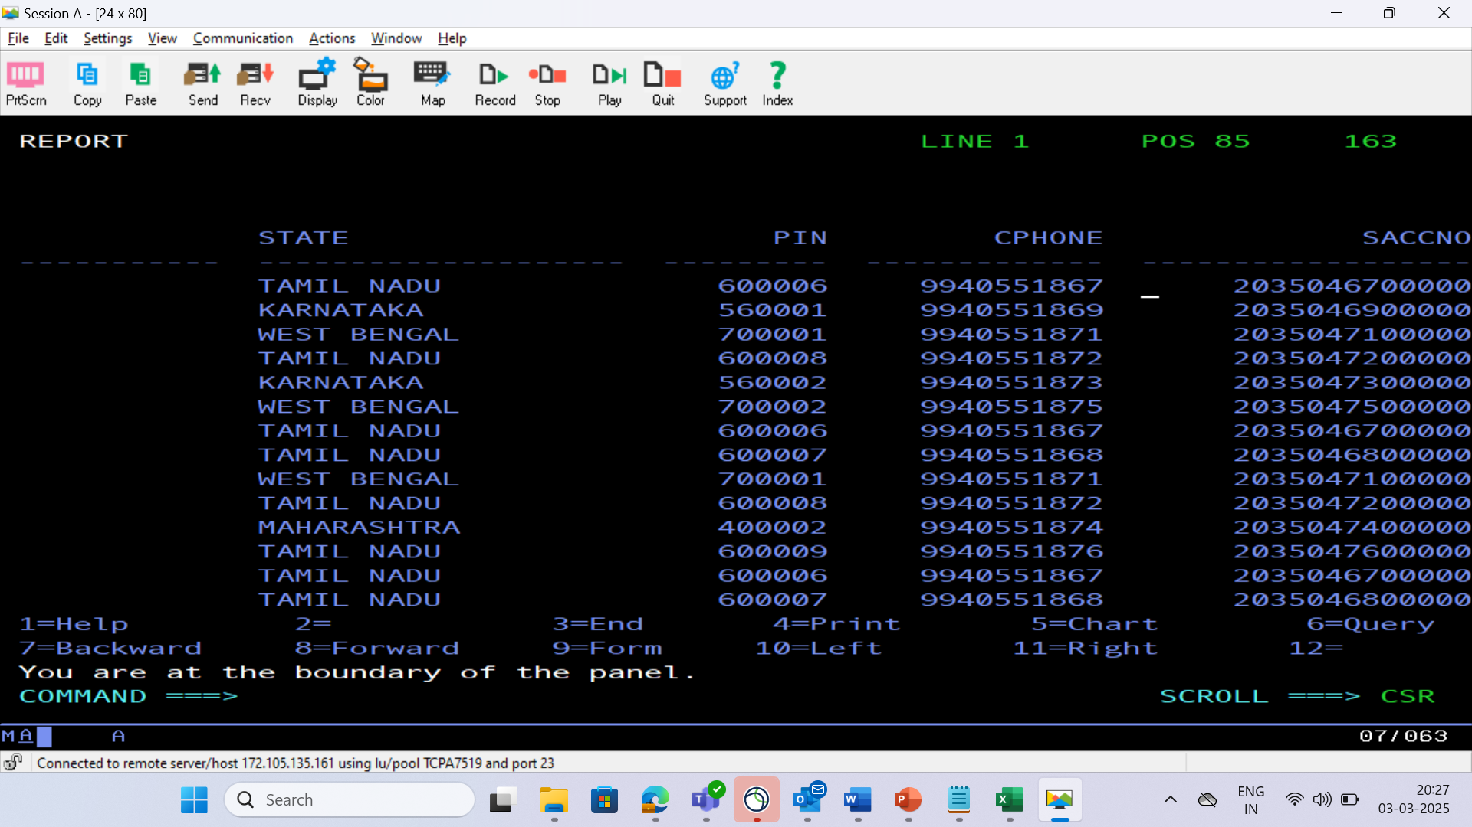

Slide 39
LOAN DATABASE - (LOAN)

Slide 41
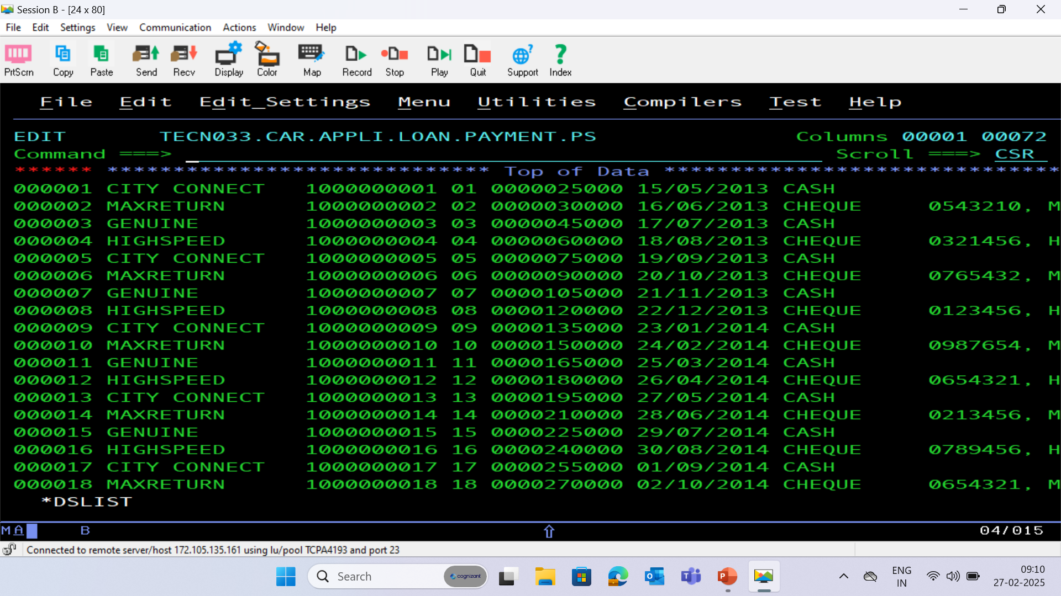
PAYMENT PS FILE

Slide 42
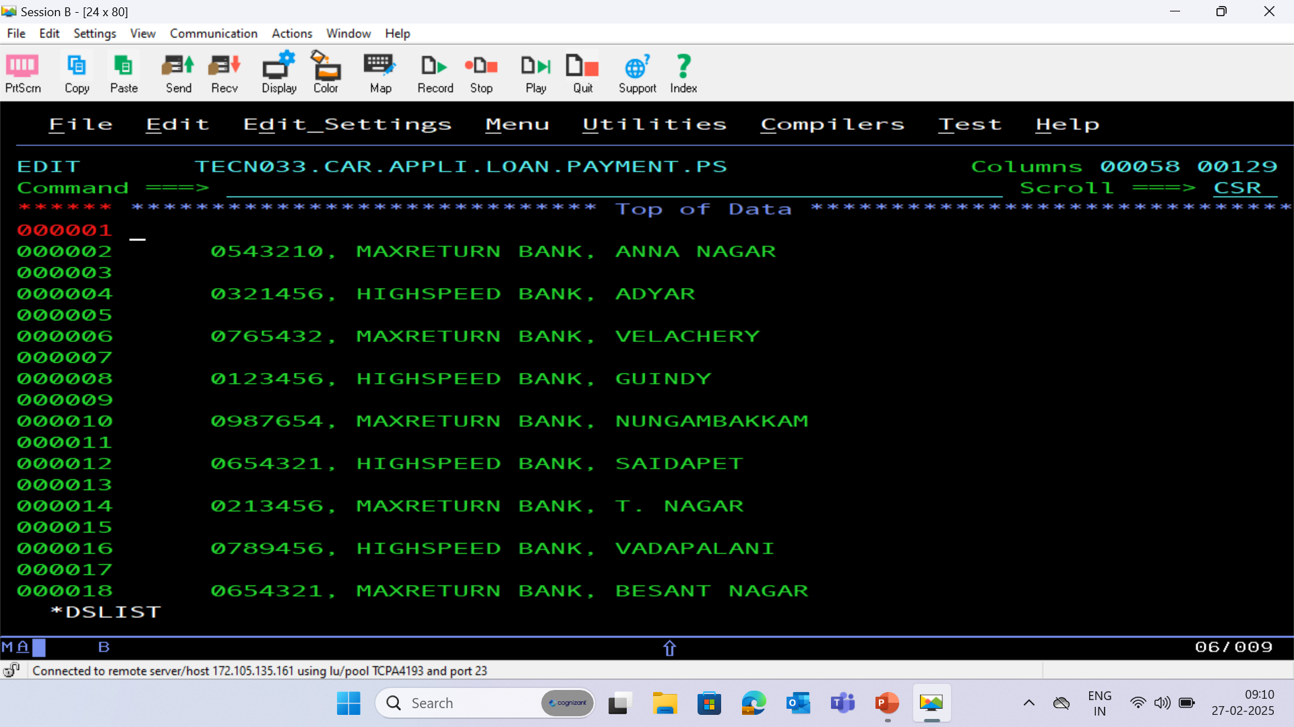

Slide 43
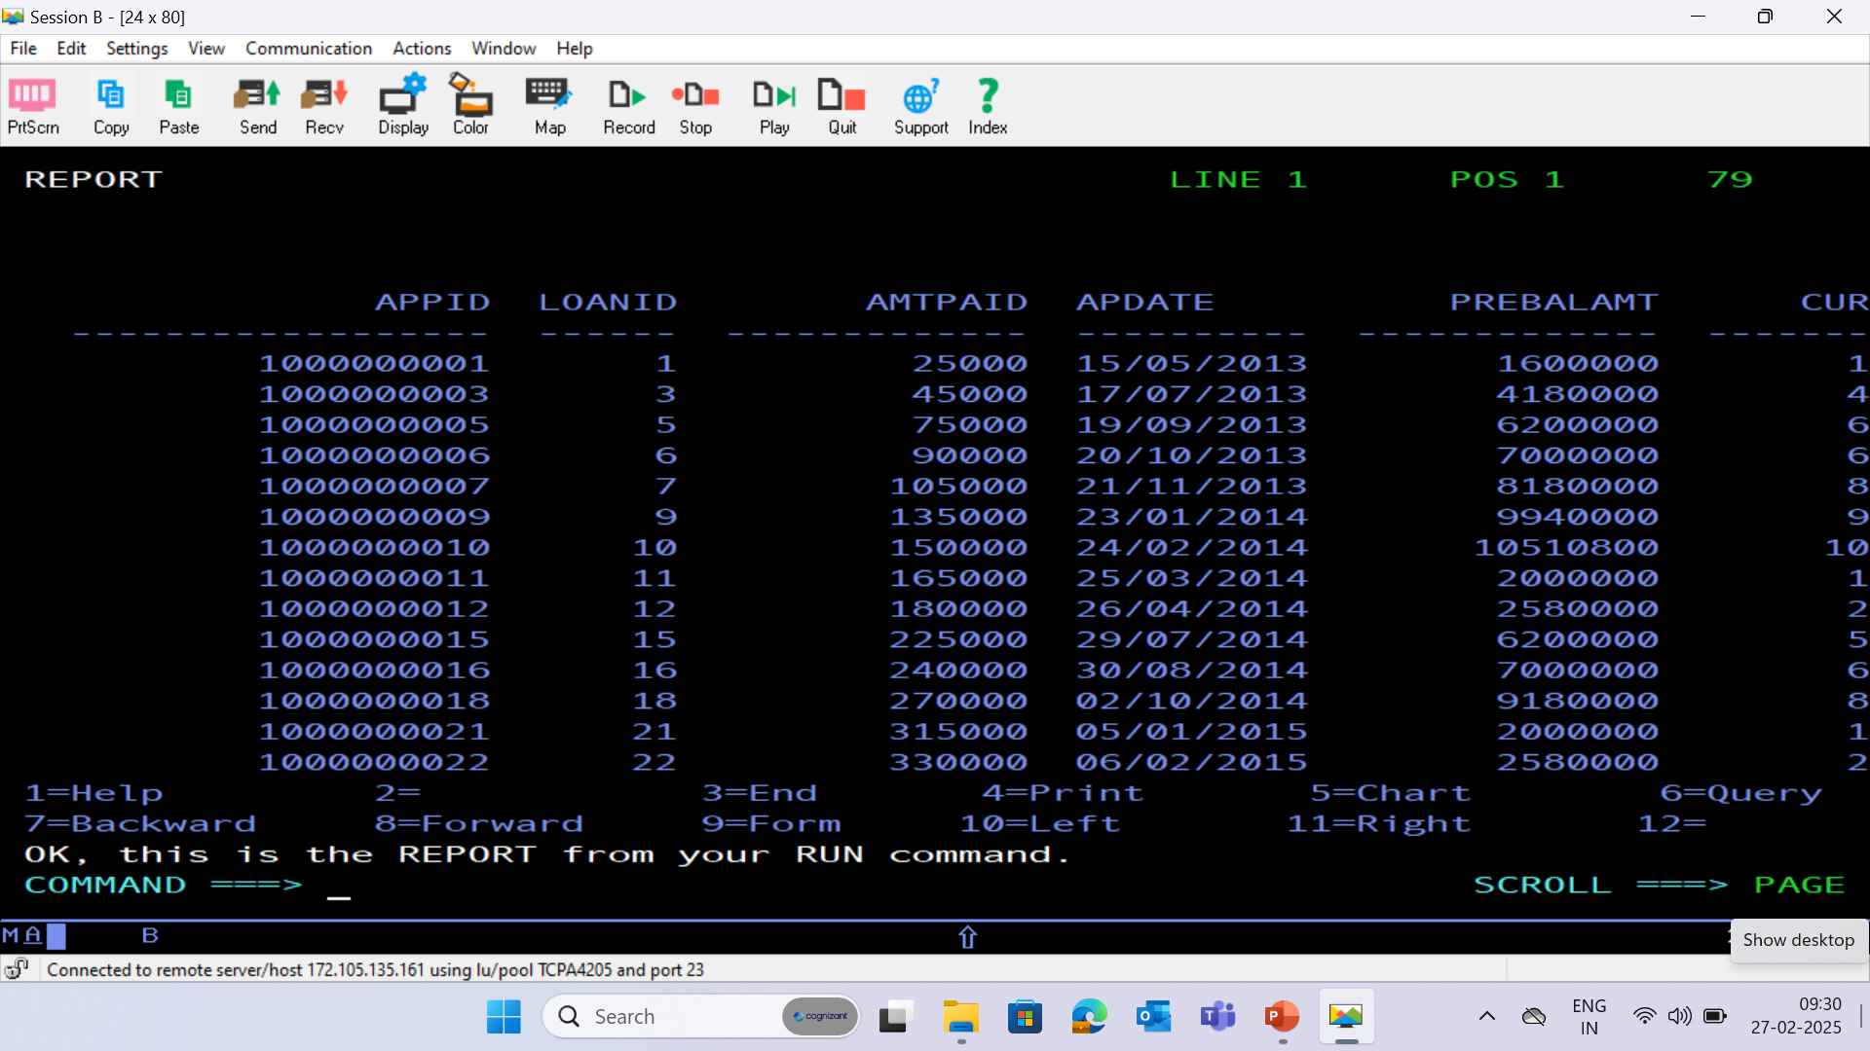
PAYMENT DATABASE - (PAYMENT)

Slide 44
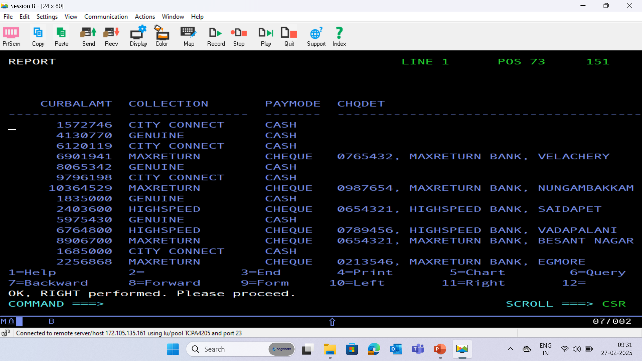

Slide 45
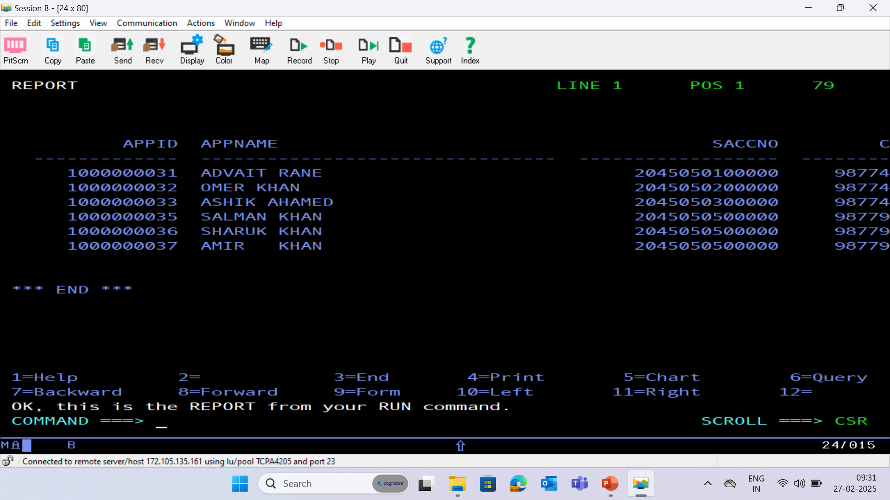
HISTORY DATABASE - (HISTORY)

Slide 46
